Slide 1
Project Bazaar Day #1
Team Name: Green
Team Members: Feras Daghmoush & Gregory Sveinbjornson

Slide 2

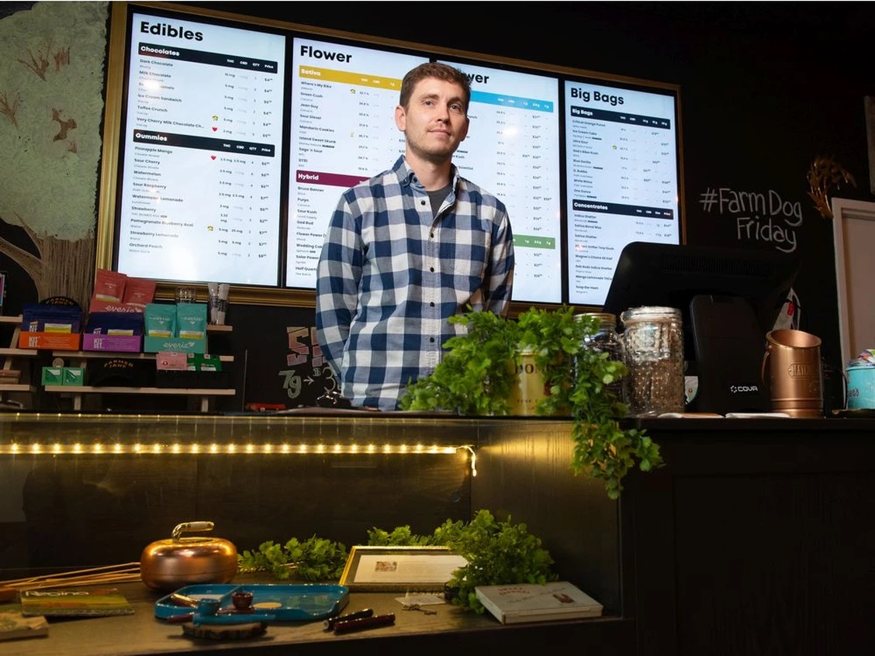
Project Background
Notes:
We , team green , are working with a company called BudSense, a Regina-Calgary startup that helps cannabis stores create better print, digital and web menus
<number>

Slide 3
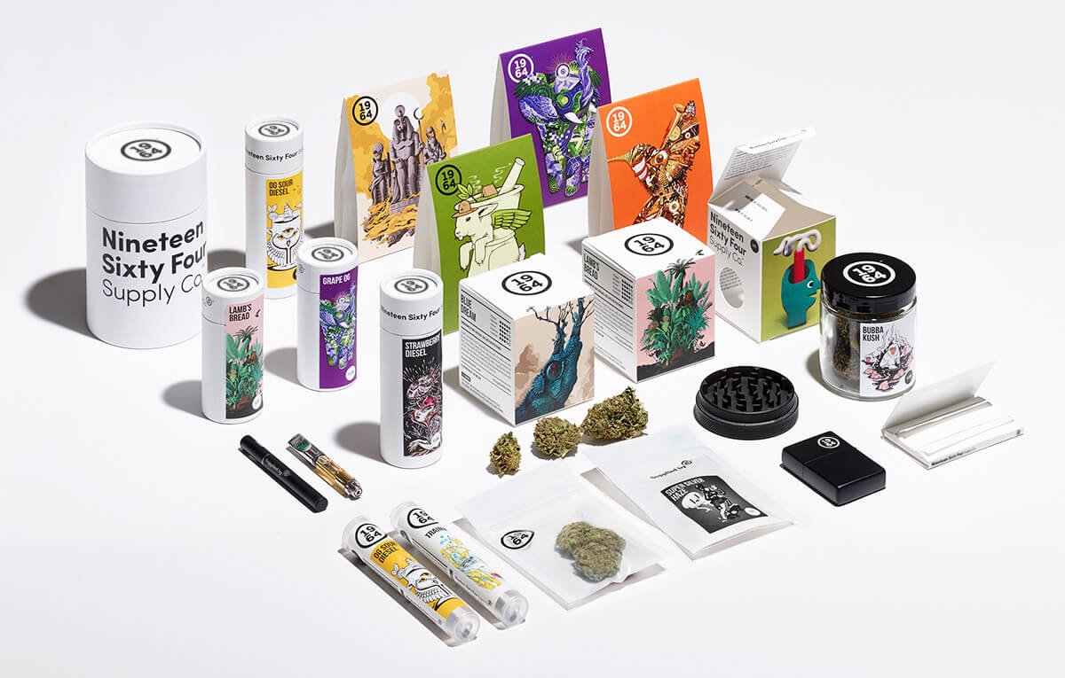
Project Background
Notes:
BudSense. Is in need of a software tool to help making the process of sorting the packages of cannabis easier
<number>

Slide 4
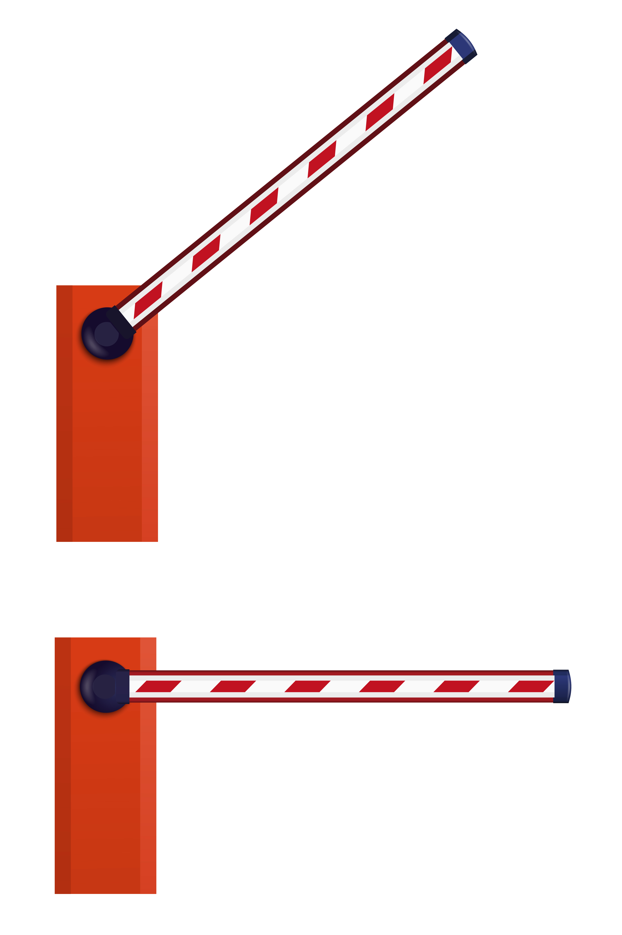
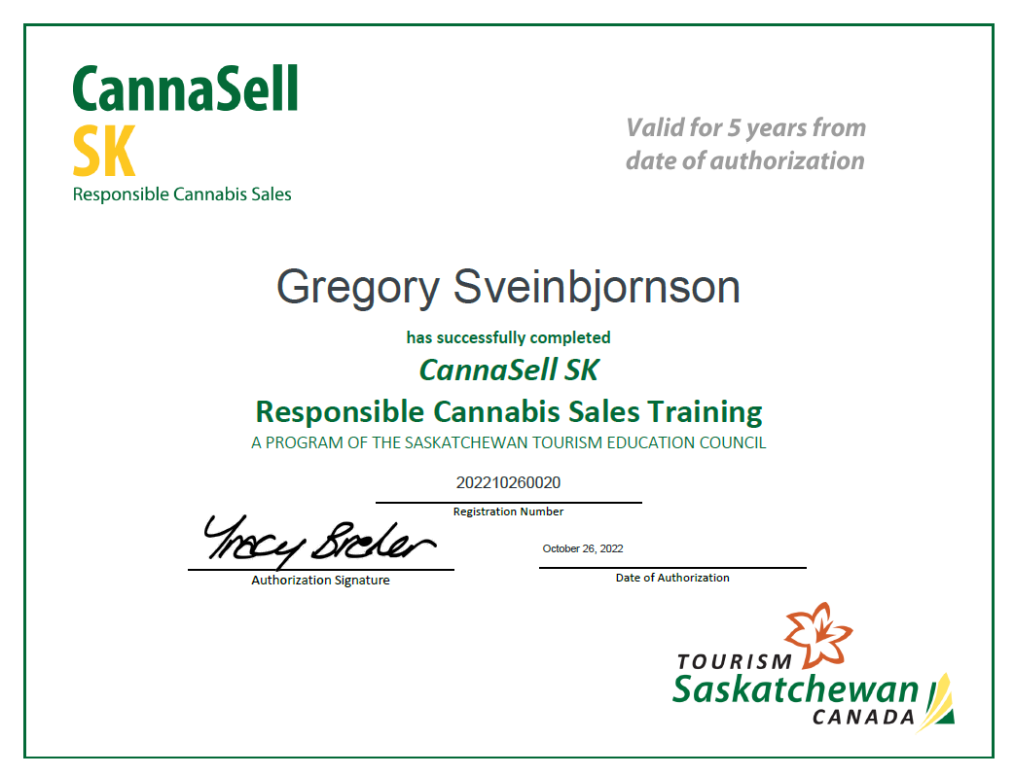
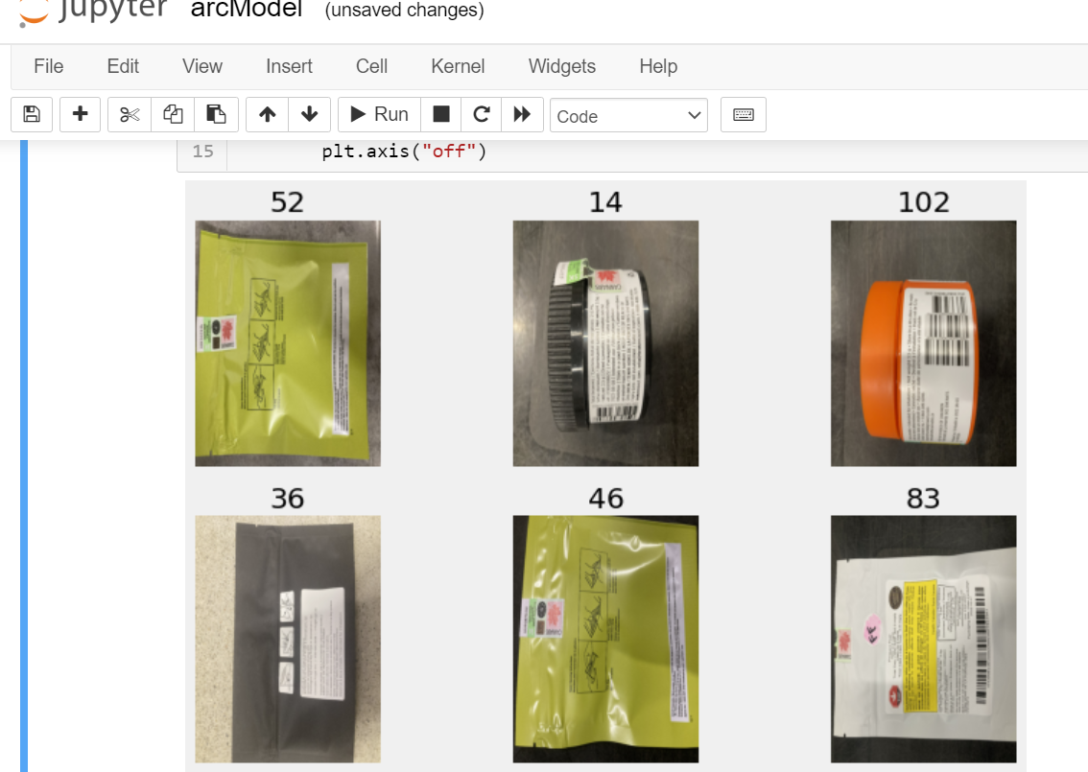
Project Obstacles and solutions
Permit needed to access stores to collect images (Solved)
Code bugs (images loaded sideways) (Fixed)
High-performance computers needed (Recently Solved)

Slide 5




Meetings Summery
Kevin Baker
Feras Daghmoush
Andrew Cretin
Gregory
Sveinbjornson
Paul Hewitt
Notes:
Highlighted notes from meeting with bud sense
Project Tooling Configuration
Setup Trello/Jira to manage task tracking
Create 1mo sprints for line of sight on tasks and to make reporting at end of capstone easier.
Create poject plan
Build out documentation around project as required for Capstone
Ideas on Data collection sources
Begin collecting of images of cannabis product pacakges
Initial data set should be of Flower products
Can be extended to other product types if data availability is there
Primarily Flower products (and flower derivatives: ie: Pre-Roll) will be the only ones with consistently changing product attributes. Edibles, capsules, oils etc. will be lab manufactured and consistent from batch to batch
Want minimum of 1000 images to begin training the model
Begin Building ML model - Dec 15, 2022
Set up Git repo for project
Use Tensorflow platform and Python language
Milestone 1 - MVP 1 - Dec 24, 2022
Data validation, retraining, modifications
Take findings from initial build, refine and retrain
Ongoing process but should have a first iteration of this complete by this date
Feedback loop for user validation
Allow for human validation to further train the model and gain accuracy
Deploy model to AWS SageMaker
Get the trained ML model into the AWS framework
API to upload image and return results from ML
BudSense team to help build out API to interface with ML model in Sagemaker
Web app for capturing images / user validation
BudSense team to help build out Angular web app to capture/upload photo and provide realtime validation
End results would be pushed into BudSense product database
MVP 2 - Final Product & Presentation - April 1, 2023
Future State - Gamification - TBD
Gamification in web app to encourage Budtenders to import new product information
Additional rewards if the item is new to the system, less if the incoming data has already been captured
<number>

Slide 6
Our plan for the next several weeks
Task | Level of attention required | Team Member
Continue working on ML model | High | Feras & Gregory
Retraining, modifications | High | Feras
Deploy model to AWS SageMaker | Medium | Gregory
Feedback loop for user validation | Medium | Feras & Gregory
Notes:
BudSense team to help build out Angular web app to capture/upload photo and provide RealTIME validation
<number>

Slide 7

Do We Feel “On Track”
Status – Yellow
We lost some time over the break with the issue of slow computing (2hrs+) for our model.
We now have access to the U of R’s ML computer, and are going to make up for lost time
Notes:
BudSense team to help build out Angular web app to capture/upload photo and provide RealTIME validation
<number>

Slide 8

What progress does the team particularly feel good (great) about?
We feel good about the data set collected and the way we are handling the input to our ML system.
We successfully passed a lot of challenges during the progress of this project.

Slide 9
What help (if any) does the team require to move positively forward?
Any coding questions will be directed to our project mentor (Trevor)
Any documentation or presentation questions will be directed to Tim
Any business or deliverable questions will be directed to the team at BudSense

